Slide 1
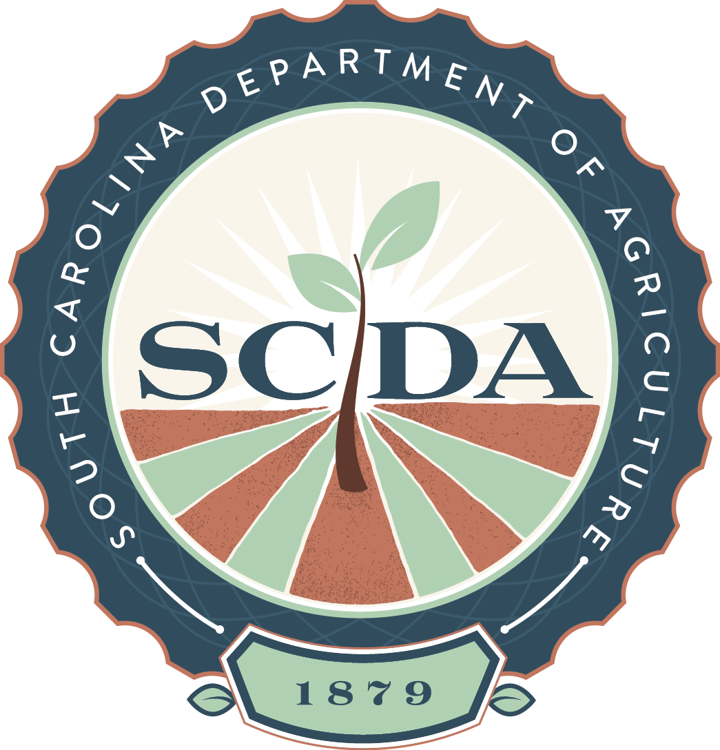
South Carolina Department of Agriculture
Hugh E. Weathers, Commissioner

Slide 2
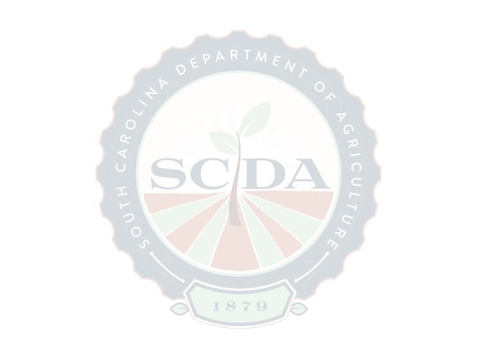
House Legislative Oversight Committee
Economic Development, Transportation, Natural Resources, and Regulatory Subcommittee
10:30 am
Wednesday, July 6, 2016
110 Blatt Building

Slide 3
South Carolina
Department of Agriculture (SCDA)
  History
  Mission
  Vision
  Key partners and relationships
  Comments

Slide 4
SC Agriculture Commissioners
A.P. Butler 1880-1890
Mr. Moore 1890-1891
Ebbie J. Watson 1904-1917
A. C. Summers 1917-1919
Bonneau Harris 1919-1925
James W. Shealy 1926-1932
J. Roy Jones 1932-1956
William L. Harrelson 1956-1976
G. Bryan Patrick, Jr 1976-1982
D. Leslie Tindal 1982-2002
Charles R. Sharpe 2002-2005
Hugh E. Weathers 2005-present

Slide 5
History
  State’s economy was built on production of crops like rice, indigo, tobacco, and cotton
  By the mid 1800’s soil became overworked and depleted
  State also lacked statistical data by which to help make decisions
  Established in 1879 with broad scope of responsibilities, including: fertilizer regulation, soil improvement and analysis, distribution of seeds, sheep husbandry, immigration, geology, labor, forestry and more

Slide 6
History
  Began under the supervision of the Board of Agriculture
    Governor (Chair and ex officio) plus four others
  Agency began with an appropriation of $168,759 (inflation adjusted)
  SCDA was initially supported by fines and forfeitures, and fees for land registration
Notes:
SC Board of Agriculture
Governor
Master of the State Grange of Patrons of Husbandry
President of the State Agricultural and Mechanical Society
2 persons elected by the General Assembly

Slide 7
History
  SC Agriculture in 1880 (US Census)
    450,756 cows
    1,350,515 acres of cotton
    78,222 acres of rice
    81,009 bushels of peaches
    Farmland – 6,259,186 acres
    Molasses 414,015 gallons (9,446 ac of sugarcane and sorghum)
Notes:
Life was different 137 years ago. Butter made on farm 3,196,851 pounds. Cheese made on farm 116,026 pounds. Sheep killed by wild predators 14,690

Slide 8
History
  In 1887, SCDA worked with South Carolina College to help set up experiment farms in Charleston, Columbia, Darlington and Spartanburg Counties
  Clemson A & M College founded in 1889 and funded by fertilizer tonnage fee
  Under the Pure Food & Drug Act in 1913, SCDA was tasked with regulating “spirituous, fermented and malted liquors;” and prevention of the sale of cocaine
  Also in 1913, the Market Bulletin was first published as part of The State Newspaper
Notes:
Regulatory programs sent to Clemson for a period after 1890, some still remain there (Plant Industry, Pesticide Regulation, State Vet)

Slide 9
History
  At least a dozen agencies have been created with responsibilities originally housed at SCDA
    Clemson Regulatory Services
    State Veterinarian’s Office
    Department of Labor, Licensing and Regulation
    Department of Health & Environmental Control
    Forestry Commission
    Department of Revenue
    State Law Enforcement Division
    DNR (Land Resources, Geological Survey, Wildlife and Marine Resources
Notes:
enforcement of commercial fertilizer and seed regulations (Clemson Regulatory)
fish commission/fishing interests - (DNR-Department of Wildlife and Marine Resources)
immigration - (LLR for migrants/B&CB Office of Research and Statistics for population stats)
geology- (DNR-Land Resources/Geological Survey/State Geologist)
sheep/livestock husbandry - (Clemson)
labor (LLR)
forestry (Forestry Commission)
commerce/ manufacturing and industry (Department of Commerce)
mining (DHEC/SC Mining Council)
statistics and real estate (LLR/SC Real Estate Commission)
quarantine of contagious animals (State Vet/Clemson Poultry and Livestock)
supervised the distribution of the first state appropriations to supplement funds from the General Educational Board (SC Department of Education)
regulatory responsibility for spirituous, fermented and malted liquors (SC Department of Revenue) prevention of the sale of cocaine and other violations which had criminal implications (SLED)
gas tax collection (SC Department of Revenue)

Slide 10
History
  SCDA has been renamed several times, with the current name being established in 1941
  1968 brought legislation that created the Agriculture Commission and the authority to create and oversee commodity boards, and administer marketing orders
  In 1974, the Columbia Farmers Market was acquired by the State and placed under the supervision of SCDA
Notes:
Some of the previous SCDA include:
State Department of Agriculture, Commerce and Immigration
State Department of Agriculture, Commerce and Industries
Department of Agriculture and Commerce
Columbia Farmers Market
Was in Columbia town hall
In 1860 moved to center of Assembly Street
1948 the General Assembly established a state agricultural marketing commission for the market
Moved to Bluff Rd in 1951
Moved to 321 in 2009

Slide 11
History
  SCDA assumed operations of the Greenville Market in 1980
  Pee Dee State Farmers Market opened in 1989
  The office of Commissioner of Agriculture became a Constitutional Office in 1982
Notes:
Qualifications for Commissioner: 46-3-30 says the Commissioner shall have a competent knowledge of agriculture, manufacturing and general industries, commerce, chemistry and publicity

Slide 12
History
  “Certified SC” campaign launched in 2007
    1,800 members currently
  In late 2009, “50 by 20 – A Ten Year Goal for South Carolina Agriculture” initiative is rolled out
  2010 - “Fresh On The Menu” restaurant program is established
    Over 300 restaurants now participating
  2011 – began partnership with SC Department of Commerce for agribusiness project manager
  In January 2014, Agritourism program created

Slide 13
History
  Agriculture today (2012 Census of Agriculture)
    Agribusiness $42 billion total impact, 212,000 jobs
    25,266 farms covering 4,971,244 acres
    Broilers are the top cash crop ($226 million)
    Total farm gate income over $3 billion
    300,036 acres of cotton (587,589 bales)
    106,476 acres of peanuts
    320,861 acres of corn
    581 agritourism operators (55% growth over 2007)
Notes:
The data reflect that agriculture is much more efficient today than in 1879, when SCDA was created. Looking back at that census I mentioned earlier, you can see that there were 4.5 times as many acres of cotton yielding not quite as much as we produce today. Same with corn – 11.7 million bushels on 1.3 million acres in 1880; today we produce 36 million bushels on 310,000 acres. 82,000 bushels of peaches in 1880, we’re looking at 70,000 tons of peaches this crop year.

Slide 14
SCDA Mission
  To promote and nurture the growth and development of South Carolina’s agriculture industry and its related businesses while assuring the safety and security of the buying public
Notes:
Legal Basis for Mission is found in Act. No. 104 of 1879.

Slide 15
SCDA Vision
  For the State’s economy to grow and prosper, providing everyone, producers and consumers, opportunities to enjoy the benefits of agriculture
Notes:
Legal Basis for Vision is laid out in SC Code 46-3-10

Slide 16
Key Partners
  Economic Development
  SC Department of Commerce
    Agribusiness recruitment
  Clemson University
    Agribusiness education and research
  University of South Carolina
    economic impact research, including current export study
Notes:
Since our partnership with Commerce began, there have been 76 agricultural projects announced, with 5,134 planned jobs and $1.9 billion in capital investments.

Slide 17
Key Partners
  Agricultural Services
  DHEC
    Farm to institution, increasing access to healthy foods, farmers market nutrition, WIC/SNAP
  PRT & Governor’s Office
    Chef Ambassador Program
  SC Department of Education
    Farm to Institution

Slide 18
Key Partners
  Agricultural Services
    USDA Agricultural Marketing Service (AMS)
      Market News
      Poultry and Egg grading
    USDA Feed Grain Inspection Service (FGIS)
      Grain grading and inspection
    USDA Food Safety Inspection Service (FSIS)
      Fruit and Vegetable grading and inspection

Slide 19
Key Partners
  Consumer Protection
  FDA
    Food and Cosmetic Act – enhanced contract inspections by FDA commissioned state inspectors
    Food Safety and Modernization Act (FSMA) – Preventive Controls and Produce Safety outreach and regulatory
    Manufactured Food Regulatory Program Standards (MFRPS) and Animal Feed Regulatory Program Standards (AFRPS) – FDA training and funding to implement federal food / feed laws and enhance laboratory capabilities

Slide 20
Key Partners
  Consumer Protection
  SC Aeronautics Commission
    Aeronautics purchased specialized equipment and SCDA inspects Jet A and 100LL dispensers at all public airports in the state

Slide 21
Key Partners
  Consumer Protection
  DHEC – MOUs to prevent redundancies
    Food Protection – SCDA inspects manufacturing, wholesale, distribution; DHEC inspects retail
    Dairy – streamlined regulation of all dairy products one agency (DHEC)

Slide 22
Key Partners
  Consumer Protection
  Clemson PSA
    Food Safety Education and training, including FSMA and Good Agricultural Practices (GAP) to prevent conflict of interest
    Pesticide Disposal Program
  USDA
    AMS – Country of Origin Labeling (COOL) enforcement
    Grain Inspection, Packers and Stockyards Administration (GIPSA) livestock scale standards
Notes:
Pesticide disposal program began again in early 2013 funded by Clemson and SCDA.

Slide 23
Key Partners
  Agency Operations
  DNR
    Tennant at the State Farmers Market
    Regional Licensing Office
  Division of Technology
    Provides network and information security support
    SCDA IT staff working with DTO to streamline products and services

Slide 24
Key Partners
  Agency Operations
  State Treasurer’s Office
    Previously combined HR department
  Lieutenant Governor’s Office
    Sourced 4,500 meals at Thanksgiving with Office on Aging

Slide 25
Public Comments

